Slide 1


Welcome, to The
Mark Adkins
Institute for Social Research York University

Slide 2

Tidy data
Our ultimate goal is to have “tidy” data
Tidy data is defined as data having the following properties:
Each variable is a column
Each observation is a row
Each type of observational unit is a table
Once data is in this format, every step of our workflow becomes easier, from modelling to visualizing our data

Slide 3
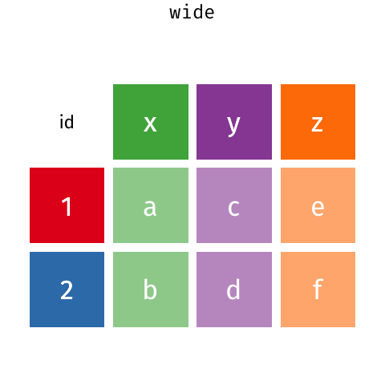
Wide vs. long
https://raw.githubusercontent.com/gadenbuie/tidy-animated-verbs/master/images/tidyr-spread-gather.gif

Slide 4
Gather & spread
The two most frequently used functions in the tidyr package are “gather” and “spread”
Often when analyzing data, there can be columns which are not variables
For example: anxiety scores across time
Subject | Time 1 | Time 2
1 | 12 | 13
2 | 8 | 7
3 | 9 | 12

Slide 5
Gather & spread
> gather(data, key = “Time”, value = “Anxiety”, - Subject)
Now, our variables each have their own column
Subject | Time | Anxiety
1 | Time 1 | 12
1 | Time 2 | 13
2 | Time 1 | 8
2 | Time 2 | 7
3 | Time 1 | 9
3 | Time 2 | 12

Slide 6
Gather & spread
The “spread” function goes the other way. Each value in the key column becomes a new column which is filled by its match in the value column
> spread(data, key = Time, value = Anxiety)

Slide 7

Gather & spread
Let’s practice by going into Rstudio now
Start by importing the file “wide_data.csv”, and take a peak at the data

Slide 8
Tidyr version 1.0.0
Since I taught this class last fall, the tidyr package has been updated and there are new/better functions.
Gather() and spread() will still be around for a while, but these new function are worth checking out.
We will focus on the new alternative for gather.

Slide 9
Pivot_longer()
Let’s try a more complicated (aka more realistic) example
Start by importing the file “data_wide_repeated_measures.csv”, and take a peak at the data

Slide 10

Dplyr – the workhorse
dplyr provides a simple set of “verb” functions that make basic data manipulation easier:
filter, select, arrange, mutate, group_by, and summarise
Each of these functions was designed to do a single job, but to do that job well!

Slide 11
Dplyr – filter
The filter function creates a subset of our data by extracting rows which meet certain criteria
For example: > new_data <- filter(data, first_name == “Bob”)
This creates a new tibble by going into our tibble/data.frame called “data”, finding the variable called “first_name”, and then finding all the rows with a value equal to “Bob”.

Slide 12
Dplyr – filter
Let’s practice using the superhero data set!
Begin by importing the data and taking a peak at it.
> superhero_data <- read_csv(“data/heroes_information.csv”)
> glimpse(superhero_data, width = 80)
Now, let’s use filter to create a subset of all the good heroes

Slide 13
Dplyr – select
The select function creates a subset of our data by extracting a set of columns we identify by name
For example: > new_data <- select(data, first_name, last_name_age)
This creates a new tibble which only has the columns we specify
We can also exclude specific columns by putting a hyphen in front of the name. e.g., select(data, -age)

Slide 14
Dplyr – select
Let’s use the superhero data we already imported and play around using the select function!
Try removing the first column
Try using the helper functions listed on the cheat sheet to select all variables which contain the word “color”
We can also rearrange the order of columns by using select function to specify a new order followed by another function “everything”

Slide 15
Dplyr – arrange
The arrange function sorts our tibble based on the values within column we specify
For example: > new_data <- arrange(data, grade, age) > new_data <- arrange(data, desc(grade), age)

Slide 16
Dplyr – mutate
The mutate function creates new variables using pre-existing variables and adds them to the end of our tibble
For example: > new_data <- mutate(data, pass_fail = grade > 50)
We can also create many new columns within one mutate function
Each new column is just another argument separated by a comma!

Slide 17
Dplyr – mutate
Let’s try this out with our superhero data!
Try adding a new column using the mutate function that calculates each hero’s BMI
Convert weight from lbs to kgs (weight times .45)
Convert height centimeters to meters (height / 100)
BMI = Weight / Height²
You can do this in steps or all at once. Whichever makes your code easier to understand and spot errors!

Slide 18
Dplyr - group_by
The “group_by“ function adds grouping meta-data to our tibbles/data.frames
Once our data is grouped, it becomes much easier to perform summary operations across all levels of our group
This meta-data is hidden behind the scenes, and it can be removed by using the function “ungroup”
Before we try this out, we will learn about the summarise function which creates a powerful combination

Slide 19
Dplyr - summarise
Summarise is a slightly different type of function than we have seen thus far
The summarise function applies summary functions to columns in our data and returns a tibble of the results
When used in conjunction with the “group_by”, a single value is return for each group

Slide 20
Dplyr - summarise
Let’s say that we wanted to find the average height for all heroes. Using base R, our code could look something like this: > mean(superhero_dat$height)
In the tidyverse it would a bit more complicated: > summarise(superhero_dat, avg_height = mean(height))
Using the tidyverse we can compute multiple summary statistics at once, all of which are returned within a single data-structure

Slide 21
Dplyr - summarise
The summarise function really shines when there are many summary functions we want to apply at once > summarise(superhero_dat, avg_height = mean(height), avg_weight = mean(weight), group_size = n())

Slide 22
Dplyr - group_by & summarise
Let’s put these two functions together
Group our superhero data by Gender (save it as a new object), then find the average height for each group

Slide 23
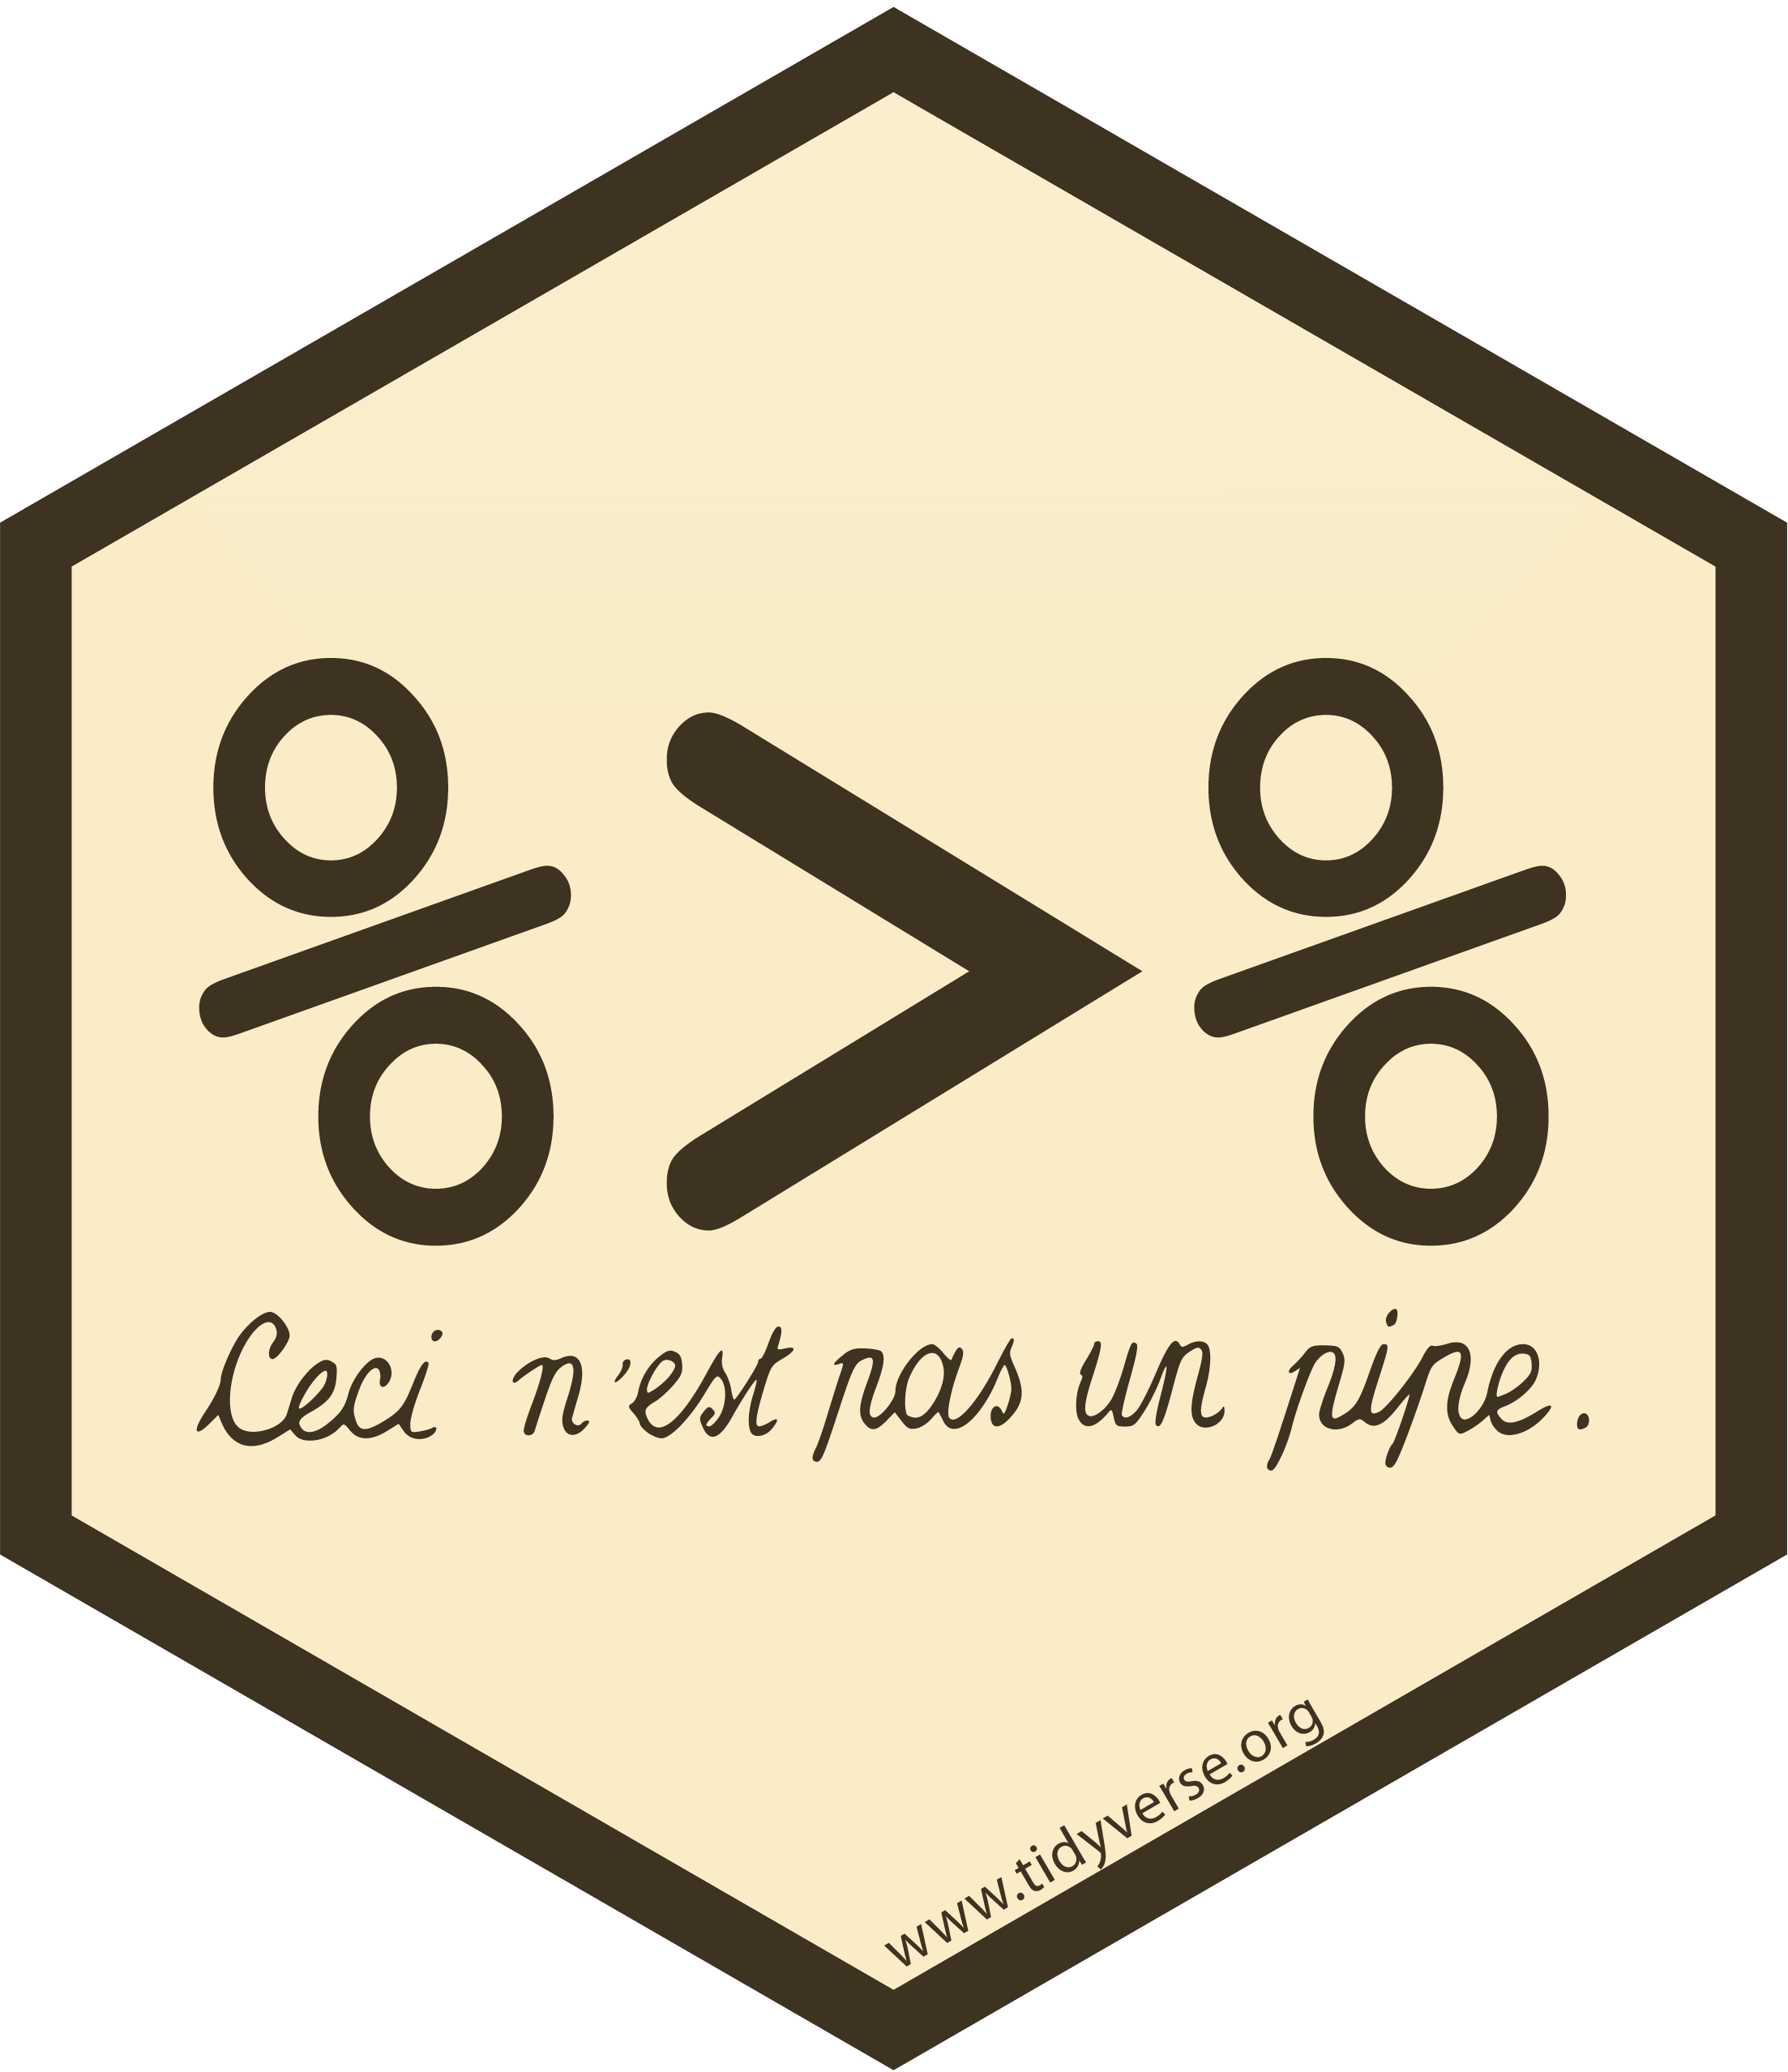
magrittr - the data pipeline
The process of cleaning our data often takes a lot of steps, and we can think of it as a pipeline
We put our raw data into one end, and once it emerges from the other it should in a format ready for analysis
The more steps we need to take to clean our data, the longer our “pipe” will become, and if we are not careful our code can be hard to debug

Slide 24
magrittr - the data pipeline
There are a couple of approaches:
Intermediate objects:
They can clutter our workspace
It can be tedious to invent new descriptive names for our intermediate objects
It is VERY easy to use the wrong intermediate object at a later point in our pipeline
Another “solution” is to nest our functions, but it quickly becomes hard to read our code and even harder to spot/fix errors

Slide 25
magrittr - the data pipeline
Another approach that solves the problem with our last two approaches is to use the pipe operator from the magrittr package, %>%
This operator takes the object from the left side of the operator and “pipes” it into the function on the right side of the operator as the first argument
Remember, tidyr and dplyr functions expect a data.frame or a tibble as their first argument, and they also return results as tibbles

Slide 26
magrittr - the data pipeline
The piping operator lets us chain together many functions in a much more human-readable way.
The pipe operator can be read as the word “then”

